Slide 1
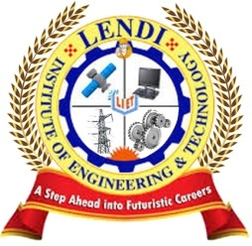
Renewable Energy Resources
Dr. D.U.S.L.Deepthi
Assistant Professor (Chemistry)
Department of S&H
Lendi Institute of Engineering and Technology

Slide 2
Contents
What is Renewable energy?
Advantages and limitations of Renewable energy
Hydropower
Geothermal power
Tidal power
Ocean Thermal Energy Conversion
Solar Energy

Slide 3
What is Renewable energy?
Renewable energy is energy that comes from a source that won't run out.
They are natural and self-replenishing. Examples of renewable energy sources include wind power, solar power, bioenergy and hydroelectric, including tidal energy.

Slide 4
Advantages and limitations of Renewable energy
Advantages
Generating energy that produces no greenhouse gas emissions from fossil fuels and reduces some types of air pollution.
Diversifying energy supply and reducing dependence on imported fuels.
Limitations
The efficiency of renewable energy is low because every type of energy requires a particular kind of technology to convert it into electricity.

Slide 5
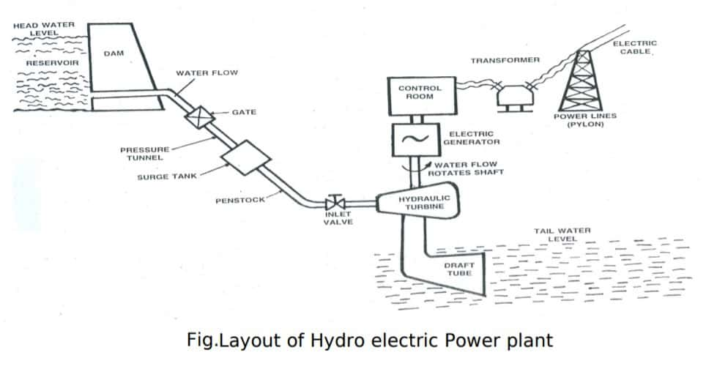
Hydropower

Slide 6
Hydropower - Working
In hydroelectric power station the kinetic energy developed due to gravity in a falling water from higher to lower head is utilized to rotate a turbine to produce electricity.
The potential energy stored in the water at upper water level will release as kinetic energy when it falls to the lower water level. This turbine rotates when the following water strikes the turbine blades.
To achieve a head difference of water hydroelectric electric power station are generally constructed in hilly areas. In the way of the river in hilly areas, an artificial dam is constructed to create required water head. From this dam water is allowed to fall toward downstream in a controlled way to turbine blades.
As a result, the turbine rotates due to the water force applied to its blades and hence the alternator rotates since the turbine shaft is coupled with alternator shaft.

Slide 7
Hydropower - Advantages
Renewable energy source.
No fuel required.
Prevents flood.
It can be used for irrigation.

Slide 8
Hydropower- Limitations
Damage the aquatic ecosystem.
Requires large areas.
Large scale human displacement.
Disruption of surrounding areas.

Slide 9
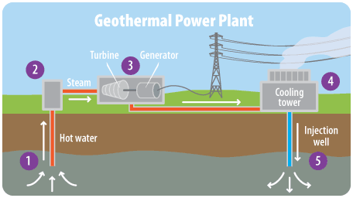
Geothermal power

Slide 10
Geothermal power - Working
The presence of hot rocks, fluid, and permeability underground creates natural geothermal systems. Small underground pathways, such as fractures, conduct fluids through the hot rocks.
In geothermal electricity generation, this fluid can be drawn as energy in the form of heat through wells to the earth's surface.
The geothermal energy in the form of heat energy can be used to generate electricity economically and efficiently. It is a renewable source of energy and is inexhaustible like solar or wind energy.
Though the amount of thermal energy within the earth is very large, useful resources of geothermal energy are very limited due to feasibility to access and extract heat.
Normally the thermal energy available inside the earth is at a depth of more than 80 km. The average temperature gradient in the earth’s surface is 30oC /km depth. Therefore, for power generation to attain temperatures up to 300 ºC, a hole has to be drilled in earth’s surface of about 10 km depth.
However, there are few sites in the world where this energy can be extracted at the depth of 0.5 to 3 km. The sites from where the thermal energy can be extracted are known as geothermal fields.
The earth’s interior having the mass of hot liquids, gases and steam are cooling slowly and the temperature of the earth’s core is about 4000 ºC.
Below the solid crust of the earth, the molten mass which is known as magma is still in the process of cooling.

Slide 11
Geothermal power - Advantages
Geothermal energy is more environmentally friendly.
Geothermal energy is a source of renewable energy.
Geothermal energy is a naturally occurring resource there is no fuel required.
Pollution levels are much lower compared to fossil fuels.

Slide 12
Geothermal power- Limitations
The largest single disadvantage of geothermal energy is that it is location specific.
Gases are released into atmosphere during digging.
Geothermal energy runs the risk of triggering earthquake.
Greenhouse gas below Earth's surface can rise to the surface.

Slide 13
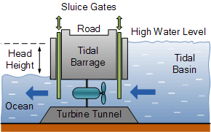
Tidal power

Slide 14
Tidal power - Working
The arrangement of this system is shown in figure. The ocean tides rise and fall and water can be stored during the rise period and it can be discharged during fall. A dam is constructed separating the tidal basin from the sea and a difference in water level is obtained between the basin and sea.
During high tide period, water flows from the sea into the tidal basin through the water turbine. The height of tide is above that of tidal basin. Hence the turbine unit operates and generates power, as it is directly coupled to a generator.
During low tide period, water flows from tidal basin to sea, as the water level in the basin is more than that of the tide in the sea. During this period also, the flowing water rotates the turbine and generator power.
The generation of power stops only when the sea level and the tidal basin level are equal. For the generation of power economically using this source of energy requires some minimum tide height and suitable site.

Slide 15
Tidal power - Advantages
Environment-friendly.
A highly predictable energy source.
High energy density.
Operational and maintenance costs are low.
An inexhaustible source of energy.

Slide 16
Tidal power- Limitations
High tidal power plant construction costs.
Negative influence on marine life forms.
Location limits.
The variable intensity of sea waves.

Slide 17
Ocean Thermal Energy Conversion
OTEC generates electricity by using the temperature difference of 20 °C (36°F) or more than that exists between the warm tropical waters at the sun warmed surface, and cold water drawn from the depth of 1000 meters.
To convert this thermal gradient into electrical energy, the warm water can be used to heat and vaporized liquid .The working fluid develops pressure as it is caused to evaporate.
This expanding vapor runs through a turbine generator and is then condensed back into a liquid by cold water brought up from depth and the cycle is repeated.
There are two types of OTEC
Closed Cycle OTEC
Open Cycle OTEC

Slide 18
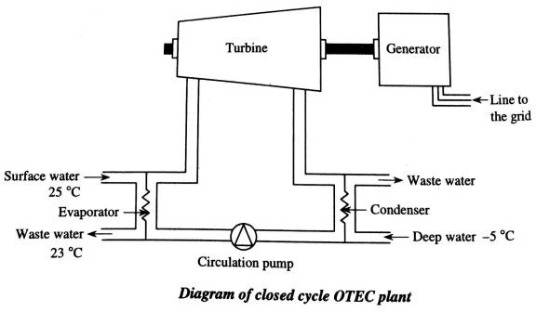
Closed Cycle OTEC

Slide 19
Closed Cycle OTEC - Working
Closed cycle OTEC employs a low-boiling-point liquid like propane or ammonia (B.P=-33℃) as an intermediate fluid. In OTEC plant first warm surface sea water is pumped through a heat exchanger to vaporize the fluid.
The expanded vapour turns the turbo generator. Cold water pumped through a second heat exchanger condenses the vapour into a liquid which is then recycled.

Slide 20
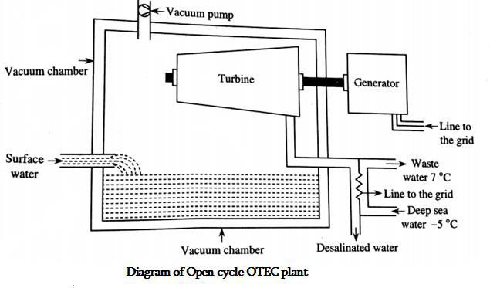
Open Cycle OTEC

Slide 21
Open Cycle OTEC - Working
Open cycle OTEC uses warm surface water directly to make electricity. The warm sea water is first pumped into a low pressure container, which causes it to boil.
In some processes, the expanding steam drives low pressure turbine attached to an electrical generator. The steam leaves its salt and contaminants in the low pressure container to give pure fresh water. It is condensed to a liquid by exposure to cold temperatures from deep–ocean water.
This method produces desalinated fresh water, suitable for drinking, irrigation and agriculture.

Slide 22
OTEC- Advantages
Warm surface sea water and cold water from the ocean from the ocean depths replace fossil fuels to produce electricity.
OTEC plants will produce little or no carbon dioxide or other polluting chemical
OTEC systems can produce fresh water as well as electricity. A lot of fish & other nutritious sea-food will be collected in outlet flow.
OTEC can also be used to produce ammonia, hydrogen, aluminium, chlorine and other chemicals.

Slide 23
OTEC- Limitations
OTEC produced electricity at present would cost more than electricity generated from fossils fuels at their current costs.
No energy company put money in this project because it only had been tested in a very small scale.
Construction of OTEC plants and lying of pipes in coastal waters may cause localized damage to reefs and near-shore marine ecosystem.

Slide 24
Solar Energy
Solar energy is the most readily available source of energy.
It is also the most important of the non-conventional sources of energy because it is non-polluting and, therefore, helps in lessening the greenhouse effect. When we hang out our clothes to dry in the sun, we use the energy of the sun.
In the same way, solar panels absorb the energy of the sun to provide heat for cooking and for heating water.

Slide 25
Harnessing the sun's energy: Solar energy can be converted to electricity in two ways:
1. Solar photovoltaic cells (SPV): Solar power is the conversion of sunlight into electricity, either directly using solar photovoltaic cells (SPV). Photovoltaic cells convert light into electric current using the photoelectric effect.
2. Concentrated solar power plants (CSP): Concentrated solar power systems use lenses or mirrors and tracking systems to reflect and concentrate slight on to receivers. That collects solar energy and converts into heat. This thermal energy can then be used to produce electricity via a steam turbine driving a generator. Two draw backs of solar energy: 1. The amount of Sunlight that arrives at the Earth‘s surface is not constant. It depends on location, time of day, time of year and weather conditions. 2. Because the Sun doesn‘t deliver large amount of energy to any one place at any one time, a large surface area is required to collect the energy at a useful rate.

Slide 26
Green House Effect, Consequences of Global Warming and Remedies to Control Global Warming
The process of heating of globe is called “Global warming”. This phenomenon is similar to that of green house or glass house in which glass roof allows solar radiation inside but prevents the escape of the terrestrial radiation (heat) generated inside the green house.
As a result, inside temperature of the green house will rise and allow tropical plants to grow on temperature soils without any discomfort hence; it takes the name of “green house effect”.

Slide 27
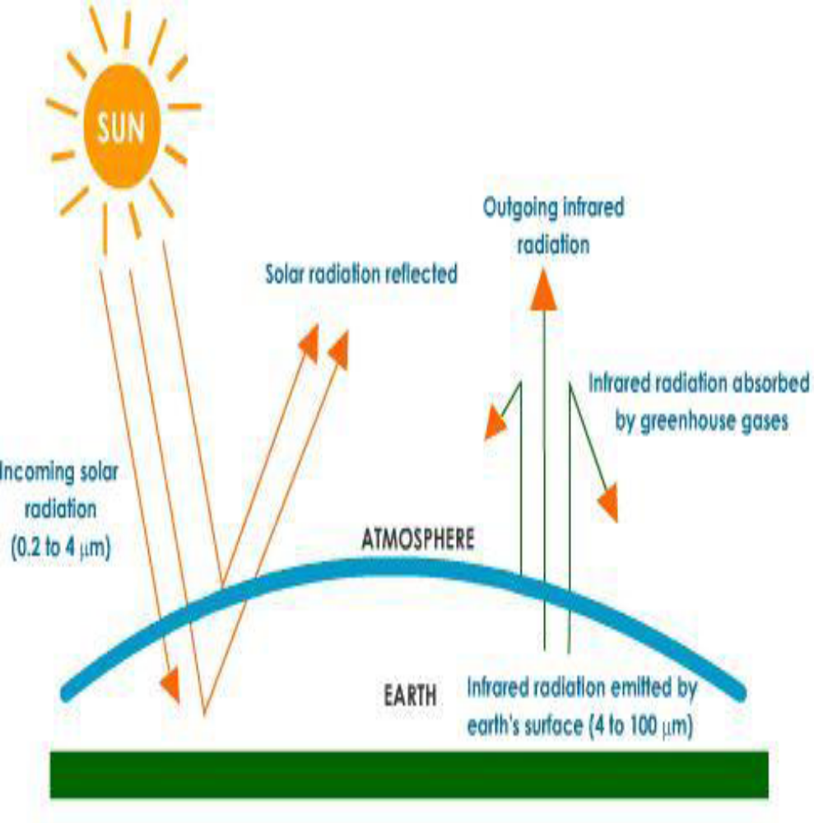
a) Carbon dioxide (CO₂): It is the most important green house gas. It contributes more than 60 per cent to the warming of the globe. It stays in the atmosphere, on average, for about 500 years.Prior to industrial revolution, the CO₂ concentration in the earth‘s atmosphere was 280 ppm and by 1994 it was 358 ppm with an annual increase of 1.5 ppm. If the same trend continues it is estimated that by the end of the 21st century the carbon dioxide concentrations may cross 600 ppm mark.
b) Methane (CH₄): It is estimated that domestic cow can produce 73,000 liters of methane per year. Its concentration is around 1 .7 ppm and increasing at a rate of 1.1% each year. Though one molecule of Methane is 25 times as effective as CO₂ molecule at trapping heat, it contributes around 15% of the total global warming. It stays in the troposphere for7- 10 years.

Slide 28
c) Nitrous oxide (N₂O): Unlike other oxides of nitrogen N₂O has longer life span (140 – 190 years) and its concentration in the atmosphere is 380 pp is rising at a rate of about 0.3 % per year, because of the increased use of fossil fuels and chemical fertilizers. One molecule of N2O is 250 times as effective as CO₂ molecule at trapping heat. It accounts for 4% of the total global warming.
d) Chlorofluorocarbons (CFCs): These are man-made, long-lived, stable and inert wonder chemicals, which are responsible for the majority of the modern man‘s comforts. Now these are mainly blamed for the destruction of protective ozone layer in the stratosphere. In addition to this, they can act as GHGs and can bring about 11% of total global warming. They are rising at the rate of 5% in the atmosphere. One molecule of CFC is 20,000 times as effective as CO₂ molecule at trapping heat.
e) Troposphere ozone (0₃): It is produced through photochemical reactions involving Hydrocarbons and Nitrogen oxides that are coming from automobile exhaust gases. It concentration in the atmosphere is about 0.02 ppm. It is 2000 times as effective as CO₂, in heat retention property. This gas along with water vapour and other gases may contribute 9% of the total global warming effect.

Slide 29
Consequences of global warming:
Melting of polar ice caps, glaciers.
Sea level rise, submergence of low lying areas — sinks coastal cities and islands. Maldives may vanish by the end of this century.
By the year 2080, Manhattan and Shanghai could be underwater.
Salt water inundation, intrusion into fresh water aquifers, Water crisis.
Shift in rainfall pattern, Change in cropping pattern.
Crop failures, Starvation, hunger deaths.
Beach erosion, Loss of biodiversity (species extinction).
Corals bleaching.
Coastline change-disputes with maritime boundaries.
1°C rise is equal to a change in latitude by 100 km.
2-5 rises is enough to have in Europe the climate of Africa today.
Drought, Desertification, Climate change, Severe storms, floods, winters, heat waves,

Slide 30
Green solutions to control global warming:
Greening of the globe can save the planet and its life: 600 million forests are necessary to prevent global warming.
Enriching oceans with iron could help to absorb phytoplankton more carbon dioxide.
Locking carbon in tropical forest biomass is the only cost effective remedy. Seriously think about Carbon capturing and Carbon burying.
Switching over to carbon free fuels. Carpooling, Mass transport, Cycle and recycle. Create market to C02. Carbon trading
Adopting low carbon lifestyles and economies. Promote Veg. diets, No car days, No-car incentives, No night time crickets.
Alternative energy sources or Renewable energy.
Solar and Nuclear power rather than thermal power.
Less Carbon intensity of fossil fuels.
Installing fluorescent lights or natural skylights. Development of new technologies, such as hydrogen cars, may reduce the consumption of petroleum and emissions of carbon dioxide.
Increased use of biofuels (such as ethanol fuel and biodiesel.
New buildings can be constructed using passive solar building design, using renewable heat sources.
Reforestation and avoided deforestation.

Slide 31
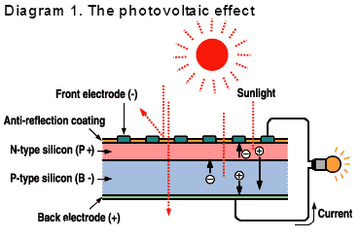
Photovoltaic Cell (Or) Solar CellConstruction and Working
A photovoltaic cell, commonly called a solar cell or PV, is the technology used to convert solar energy directly into electrical power. A photovoltaic cell is a non mechanical device usually made from silicon alloys.When photons strike a photovoltaic cell, only the absorbed photons provide energy to generate electricity.
When enough Sunlight (energy) is absorbed by the material (a semiconductor), electrons are dislodged from the material‘s atoms, Special treatment of the material surface during manufacturing makes the front surface of the cell more receptive to free electrons, so the electrons naturally migrate to the surface. When the electrons leave their position, holes are formed.
When many electrons, each carrying a negative charge, travel toward the front surface of the cell, the resulting imbalance of charge between the cell‘s front and back surfaces creates a voltage potential like the negative and positive terminals of a battery. When the two surfaces are connected through an external load, such as an appliance, electricity flows.

Slide 32
Some advantages of photovoltaic systems are:
Conversion from Sunlight to electricity is direct, so that bulky mechanical generator systems are unnecessary.
PV arrays can be installed quickly and in any size.
The environmental impact is minimal.
Requiring no water for system cooling.
Generating no by-products

Slide 33
SPV can be used for a number of applications such as:
Domestic lighting and street lighting.
Village electrification.
Water pumping.
Desalination of salty water.
Powering of remote telecommunication repeater stations.
Railway signals.

Slide 34
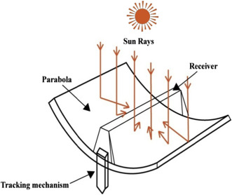
A parabolic trough:
It is a type of solar thermal energy collector. It is constructed as a long parabolic mirror (usually coated silver or polished aluminum) with a Dewar tube running its length at the focal point. Sunlight is reflected by the mirror and concentrated on the Dewar tube. The trough isusually aligned on a north-south axis, and rotated to track the sun as it moves across the sky each day.Heat transfer fluid (usually oil) runs through the tube to absorb the concentrated sunlight. This increases the temperature of the fluid to some 400°C. The heat transfer fluid is then used to heat steam in a standard turbine generator. The temperature of the heat transfer fluid quickly reaches 750 degrees as the sun's energy is captured by the Parabolic Troughs. The overall process is very economical and thermal efficiency ranges from about 60% to as high as 80%.

Slide 35
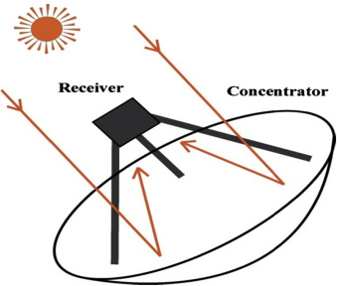
Parabolic dish systems
Parabolic dish systems consist of a parabolic-shaped point focus concentrator in the form of a dish that reflects solar radiation onto a receiver mounted at the focal point. These concentrators are mounted on a structure with a two-axis tracking system to follow the sun. The collected heat is typically utilized directly by a heat engine mounted on the receiver moving with the dish structure.

Slide 36
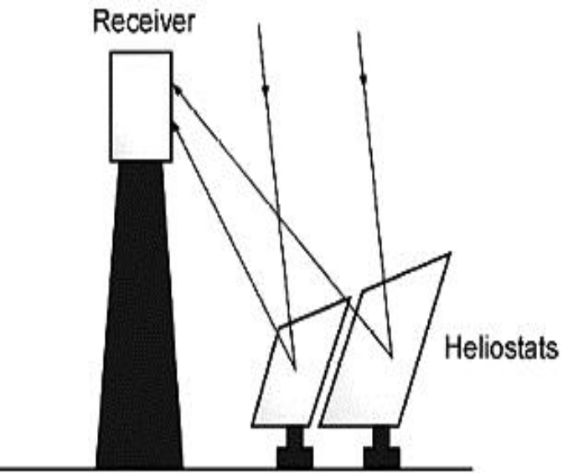
Solar power towers
Solar power towers generate electric power from sunlight by focusing concentrated solar radiation on a tower-mounted heat exchanger (receiver). The system uses hundreds to thousands of sun-tracking mirrors called heliostats to reflect the incident sunlight onto the receiver. In a molten-salt solar power tower, liquid salt at 290ºC (554ºF) is pumped from a Cold‘storage tank through the receiver where it is heated to 565ºC (1,049ºF) and then on to a ‗hot‘ tank for storage. When power is needed from the plant, hot salt is pumped to a steam generating system that produces superheated steam for a conventional Rankine- cycle turbine/generator system. From the steam generator, the salt is returned to the cold tank where it is stored and eventually reheated in the receiver.

Slide 37
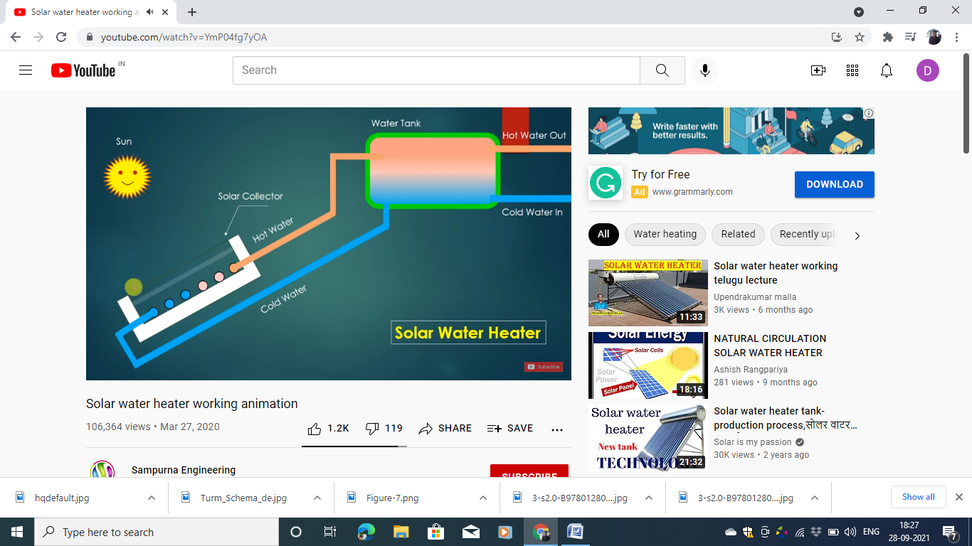
Solar water Heater- Working
The collectors are glazed on the sun facing side to allow solar radiation to come in. A black absorbing surface (absorber) inside the flat plate collectors absorbs solar radiation and transfers the energy to water flowing through it. A black surface heats up when left in the sun, by absorption of solar radiation; The good absorption property of black surfaces is used to improve solar energy absorption in a solar heater Heated water is collected in the tank which is insulated to prevent heat loss. Circulation of water from the tank through the collectors and back to the tank continues automatically due to density difference between hot and cold water (thermosyphon effect).

Slide 38
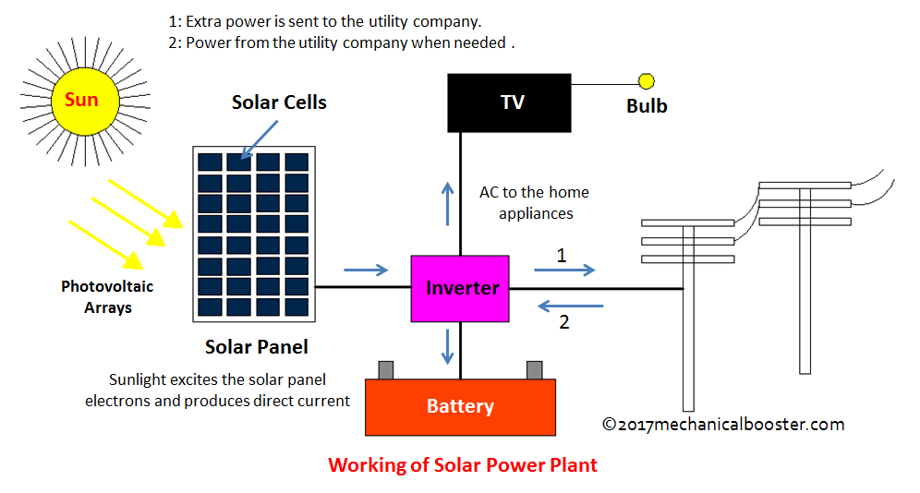
Solar power plant- Working:

Slide 39
Power plant work
Solar Panels: The solar power plant comprises thousands of solar panels, which are made up of semiconductor materials like silicon. When sunlight hits the solar panels, it excites electrons in the semiconductor, creating a flow of direct current (DC) electricity.
Inverters: The DC electricity generated by the solar panels is then sent to inverters, which convert it into alternating current (AC) electricity. AC electricity is the standard form of electricity used in homes and businesses.
Transformer and Grid Connection: The AC electricity is then passed through a transformer to increase its voltage to the appropriate level for grid transmission. Afterward, the electricity is fed into the electrical grid through power lines, supplying renewable energy to homes and businesses.

Slide 40
Applications of Solar energy
As heat for making hot water, heating buildings and cooking.
To generate electricity with solar cells or heat engines
To take salt away from the sea water.
To use sun rays for drying clothes and towels.
It is used by plants for the process of photosynthesis.
To use in cooking solar cookers.

